Slide 1
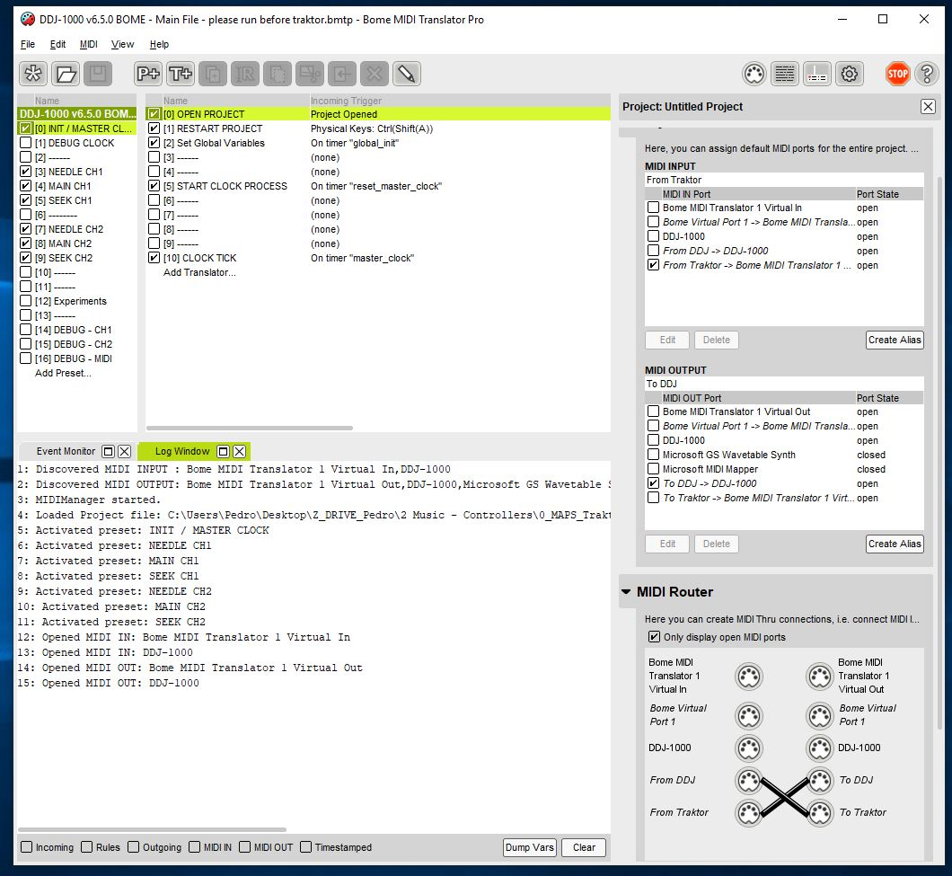
1) BOME - Correct startup log
4x messages here!

Slide 2
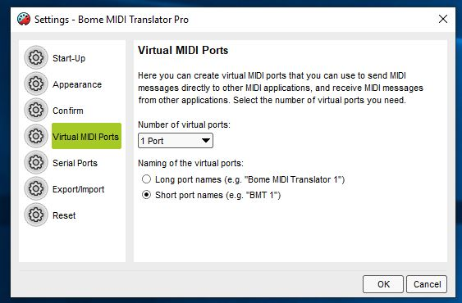
2) BOME - configuration virtual device
Short port names!

Slide 3
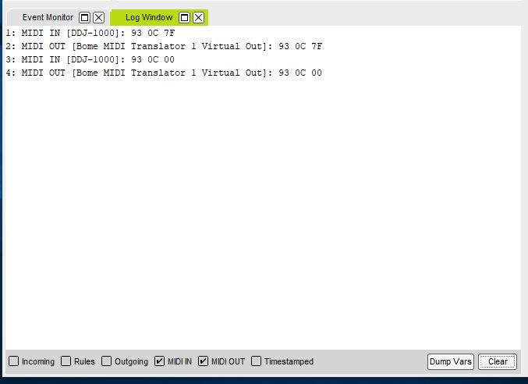
3) BOME - debug DDJ to Traktor flow
Pressing and releasing any button generates 4 log lines. This is always in the DDJ->BMT1 direction

Slide 4
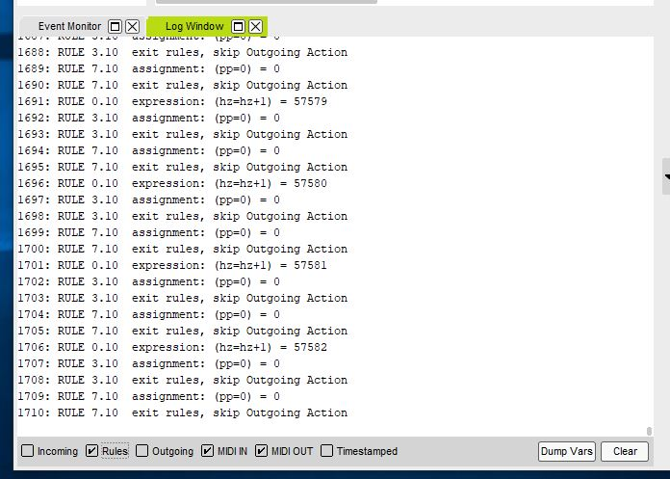
4) BOME - debugging bome clock
HZ goes up one by one continuously

Slide 5
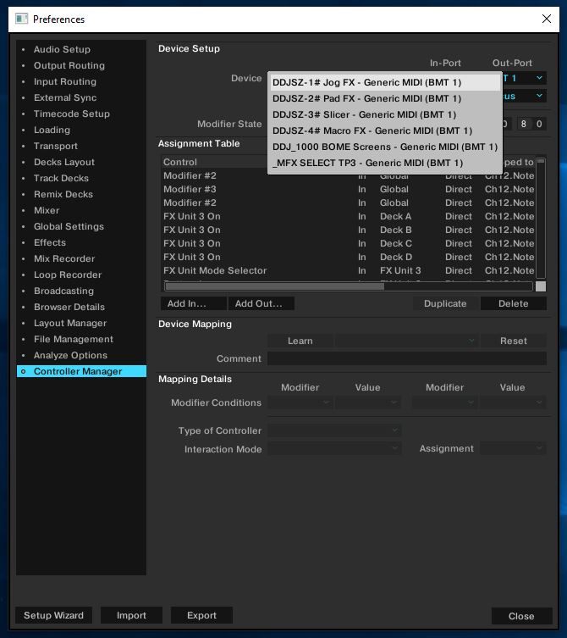
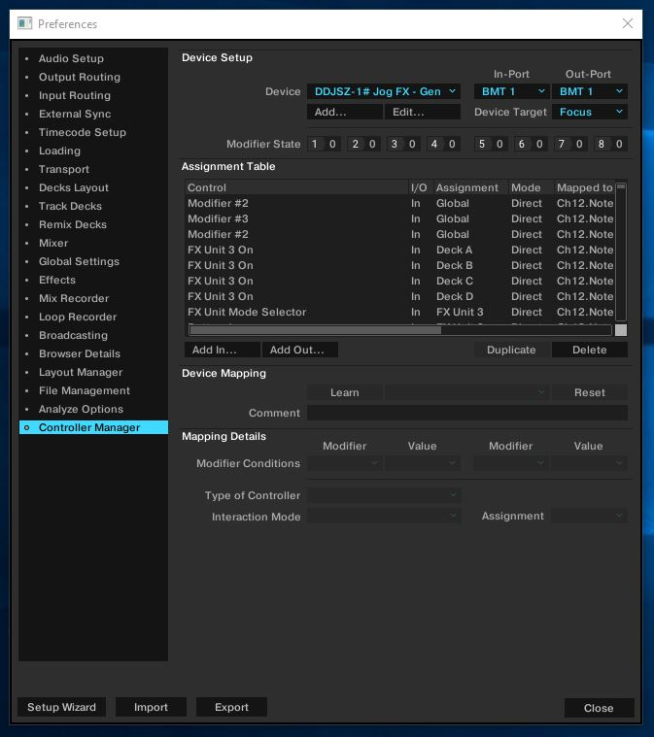
5) TRAKTOR – Controller manager devices
All pages with “BMT1”
Both IN and OUT = “BMT1”

Slide 6
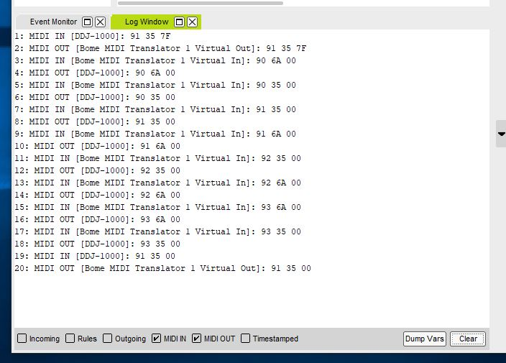
6) BOME - debugging bidirectional flow
Pressing and releasing any button generates at least 8x log lines. This is both in the DDJ->BMT1 direction and the BMT1->DDJ direction

